Slide 1

Bank Marketing Analytics
Marketing Analytics – Individual Project
Student Name: Srilakshmi Gummadidala

Slide 2

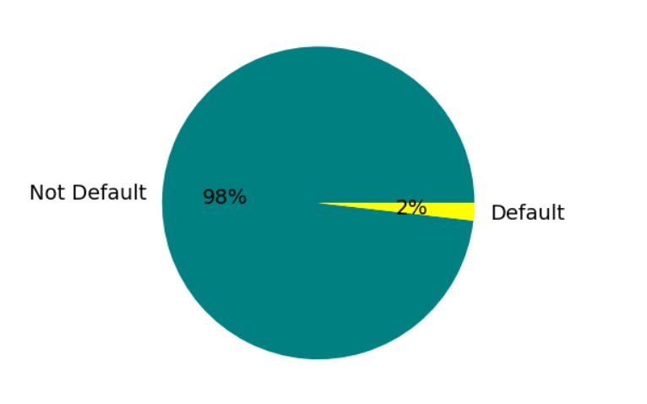
Customer Default Rate
A notable imbalance, with approximately 98% of instances representing non-defaulters and only 2% representing defaulters.
This highlights the need for focused strategies to address and attract potential clients who might be more inclined to subscribe to term deposits.

Slide 3
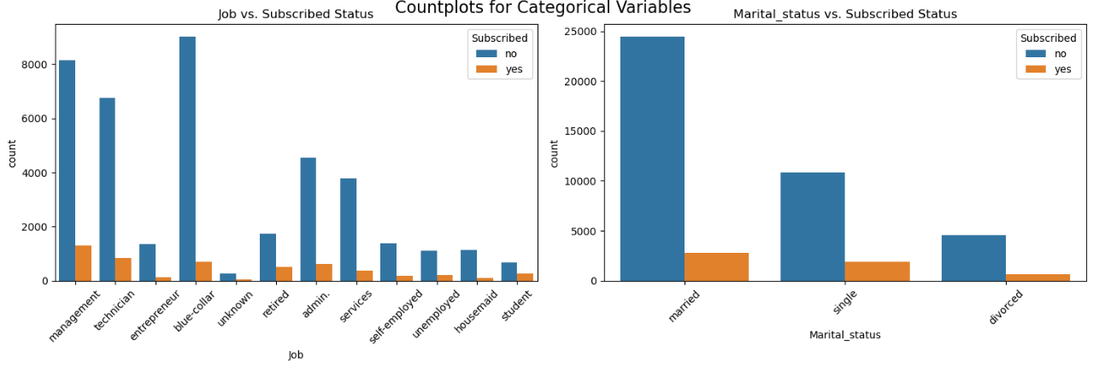
Job and Marital Status Distribution over Subscription Status
Non-subscribers to term deposits are predominantly associated more with blue-collar jobs, suggesting lower interest in term deposits among individuals in manual or industrial occupations.
Married individuals show a higher representation among term deposit subscribers, emphasizing the importance of tailoring deposit offerings to different marital segments.

Slide 4
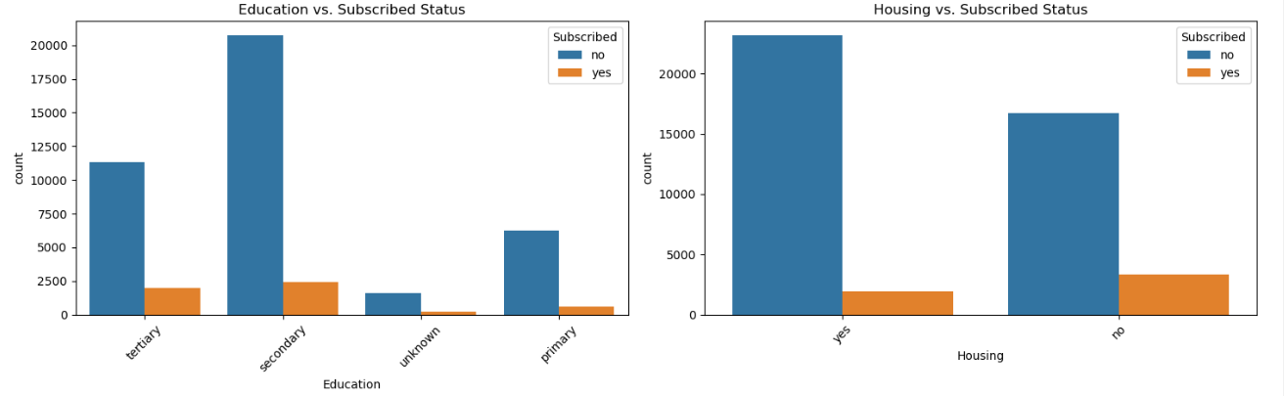
Education and Housing Distribution over Subscription Status
Both term and non - term deposit subscribers are primarily individuals with a secondary education level, guiding strategies to tailor communications based on educational backgrounds.
A substantial portion of customers with housing loans did not subscribe to term deposits, highlighting the need to evaluate the relationship between housing loans and term deposit subscriptions.

Slide 5
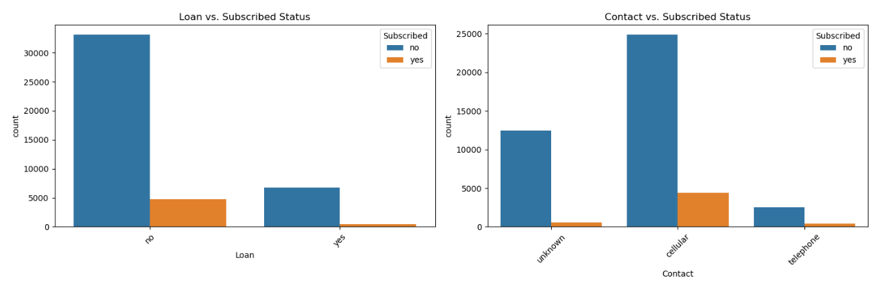
Loan & Contact Distribution by Subscription
Most customers who subscribed to a term deposit do not have personal loans. Understanding the prevalence of personal loans among subscribers assists in designing targeted deposit offerings.
Among subscribers to term deposits, the cellular contact method is the most common. This insight is valuable for optimizing communication channels, particularly for marketing term deposit products.

Slide 6
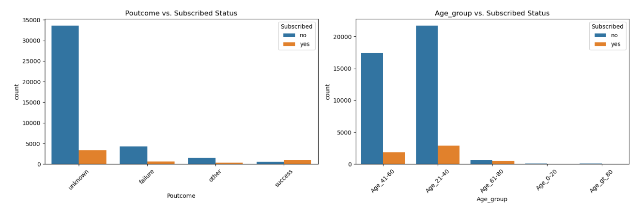
Campaign Outcome & Age Group Distribution
Most subscribers have an unknown outcome from the previous campaign, highlighting the need to enhance tracking and analysis for better future campaign strategies.
The 21-40 age group dominates term deposit subscriptions, emphasizing the importance of tailoring products to diverse age demographics.

Slide 7
Conclusions
Customer Profiling
Key demographic: 21 to 40 years age group.
Targeted marketing efforts tailored to this age segment could be highly effective.
Communication Channels
Cellular communication is dominant.
Improve tracking of past campaign outcomes, especially those marked as unknown.
Financial Insights
Majority of account balances below 5000.
Consider developing financial products for customers with lower balances.
Marketing Calendar
Peak interactions in May; align marketing efforts accordingly.
Feature Importance
Focus on blue-collar jobs, married status, and secondary education in messaging and product offerings.

Slide 8
Recommendations
Communication Optimization
Enhance communication strategies based on preferred channels.
Product Development
Explore tailored products for customers with lower account balances.
Strategic Calendar Planning:
Align marketing efforts with peak months for maximum effectiveness.
Customer Feedback Mechanism
Establish feedback mechanisms for customer preferences.
Cross-Department Collaboration
Foster collaboration across departments for a holistic customer approach.
Improve tracking and reporting for past campaigns.
Share insights to align strategies and improve overall customer experience.

Slide 9
THANK YOU !

